Slide 1
Zotero for librarians
Gemma Walsh and Nicole Le Grand
University of Melbourne

Slide 2
Notes:
We would like to begin by respectfully acknowledging the Traditional Owners and custodians of the unceded land we are presenting from today: the Wurundjeri people of the Kulin nations, their ancestors and Elders, who continue to create and share knowledge as part of the longest continuing culture in the world. I'd also like to extend our respect and a warm welcome to any First Nations people joining us today.

Slide 3
Agenda
1
2
3
4
5
Why Zotero?
Create items, collections and groups
Tag and annotate
Report
Support

Slide 4
Why Zotero?
Gather, store and organise references
Share references with others
Use with Word / Google Docs to automate parts of the process
Contains AGLC as a citation export style

Slide 5
Features
Open source with active user community
Directly imports articles from web searches
Helps organise articles of interest
Enables users to annotate PDFs
Advanced search functions of metadata and notes
Easy Word/Google Docs integration
Customisable with add-ons and plug-ins

Slide 6
Set up
Common issues
No Zotero icon in Chrome?​
Check you have the Connector extension downloaded and pinned via the jigsaw icon.​
If you do, open Chrome, log out of any Gmail or Google apps and re-download the Connector.​
No Zotero in Word?​
The Word processor plug-in should be automatically added so you can cite while you write.
If not, check Zotero Preferences under Cite and ‘Install Microsoft Add-in’. If this doesn’t work, there might be a block in your Word app.
Download Zotero AND Zotero Connector​ via zotero.org
Register a Zotero account with a personal email address​
Add the AGLC style and save as your export style​
Check you can see the Zotero tab in Word and the Connector in Chrome
Notes:
Zotero.org > Log in > Register for a free account

Slide 7
Sync
When to sync
Syncing can be set to manual or automatic via Zotero Preferences > Sync links
If your library is large, manual syncing may be more efficient.
Remember to sync when you open your library and before you close your library, particularly to avoid duplication in group libraries.
Register for an account via Zotero.org
Register a Zotero account with a personal email address​
Log in. You can access your library from anywhere.
Return to Zotero. Log in and sync via Preferences > Sync links.
Notes:
Zotero App > Edit > Preferences > Sync > Insert credentials

Slide 8
Create
Add items to your Zotero library.
Annotate
Search, report, export
Create reports based on item tags, notes or authors to help with future research.
Tag
Ensure your items are easy to find later by tagging the items.
Annotate PDFs while you read, generating notes as you go. Notes can also be tagged.
Create folders to keep them organised and share.

Slide 9
Create and share

Slide 10
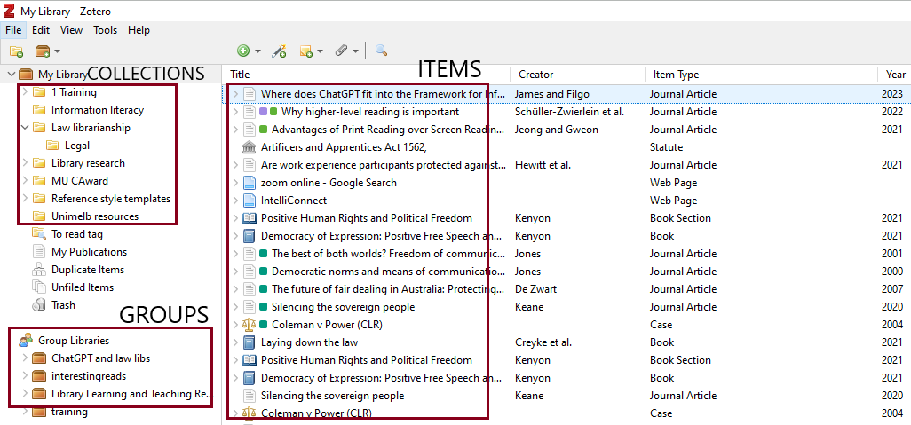
Items, collections and groups

Slide 11
Adding items
Create
Add items to your Zotero library
Create folders to keep them organised
Collaborate and share via Groups
Manually within Zotero
Select the ‘plus’ icon , the ‘wand’ icon or menu navigation [File > New Item]
Select the item type (this is important as it affects your output style and helps you search for the correct item later)
Complete the item fields, including tags
Manually attach PDF if required
Scrape/import from the web or a database
Use Zotero icon with your web browser to import an article or search results
Any database will allow some sort of automatic export, though the quality varies
Will need to check the item fields, manually amend and add PDF if it didn’t come across
Notes:
Very useful to store pd information and interesting articles that can then be searched.

Slide 12
Collections
Create
Add items to your Zotero library
Create folders to keep them organised
Collaborate and share via Groups
Yellow folder icon in Zotero
Create folders and sub-folders in Zotero to organise your materials. These are called collections.
To create a new collection, go to the yellow folder icon on the far left and click to add. Name the collection in the pop-up box.
You can create collections within collections, or sub folders. To add a folder within an existing collection, right click on the folder and select 'New Sub collection' and type in a name.
Add items to collections by dragging and dropping them into the folder. Remove items from folders by right clicking and selecting 'Remove Item from Collection'. This will not delete the item from your library. Avoid deleting items as that will inadvertently delete the item from all collections.
Rename collections or sub-folders at any time by right clicking on a folder and selecting 'Rename Collection’.

Slide 13
Group libraries
Create
Add items to your Zotero library
Create folders to keep them organised
Collaborate and share via Groups
Brown folder icon in Zotero
To use the group function, you must set up an account at Zotero.org and make sure it is linked to your Zotero App via Preferences > Sync.
To create a new group, click the brown folder icon (top left of library) and select ‘new group’. This will open Zotero online in your browser.
From this site you can search for other members or groups, or create a new group and invite Zotero members to join.
Add items to groups the same way as you do for collections. Rename collections or subfolders at any time via Zotero.org > Groups by right clicking on a folder and selecting ‘Rename Collection’.

Slide 14
Tags

Slide 15
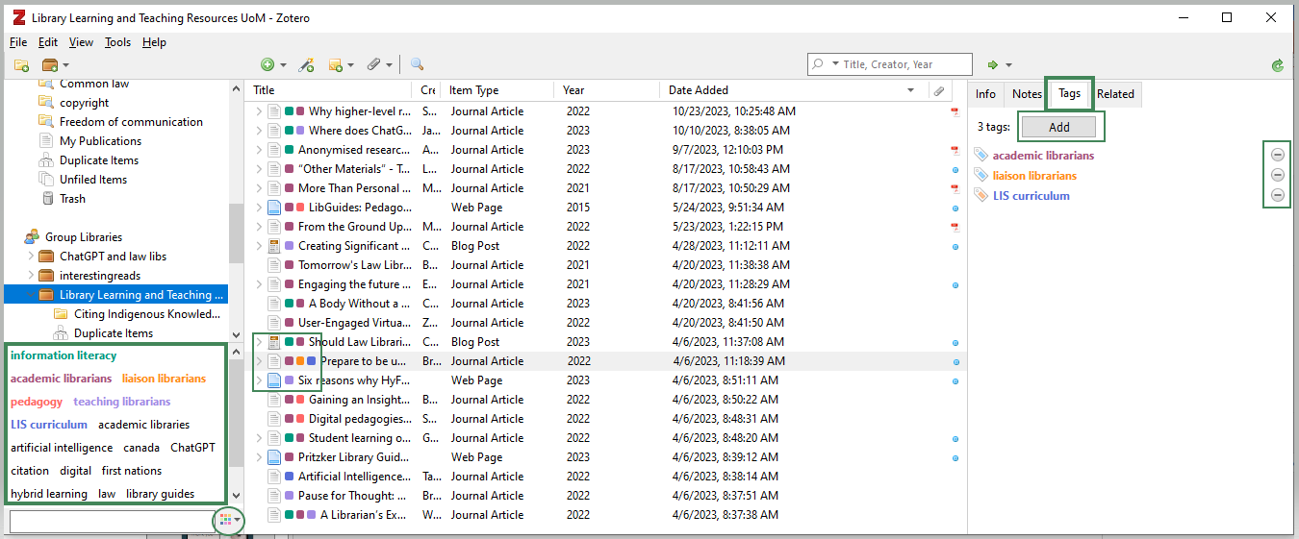
Zotero tags
Notes:
Can be used for items and notes to help categorise and find your items.
Note: Biggest regret from users is that they didn’t think about their tags and use them properly from the start.

Slide 16
Tagging items
Tag
Ensure your items are easy to find later by tagging the items.
Add custom tags to items in your library and use them to quickly retrieve related items.
Tags Tab: View, add and remove tags
Tag Cloud: Review tags in the collection or folder selected. Clicking on a tag will display all items tagged with that term.
You can colour code your tags. This will add a coloured square to the item in the middle panel.
Bulk tagging: Select multiple items in the middle panel and drag the highlighted records on to the tag in the left tag window.

Slide 17
Notes and annotations

Slide 18
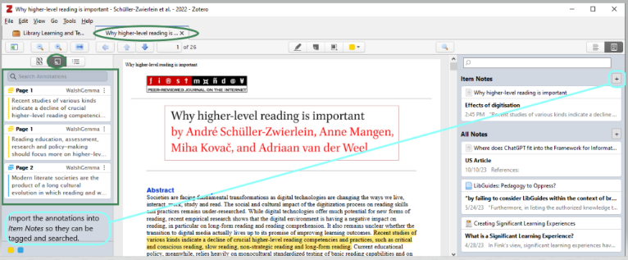
Notes and PDF annotations
Zotero Library
Create notes from:
Zotero library items
Within PDF Reader
PDF annotations
PDF Reader
Notes:
Note: Some imported items include pdfs, others don’t. Depends on the database.

Slide 19
Notes and PDF annotations
Annotate
Annotate PDFs as you read them, generating notes as you go. Notes can also be tagged.
The Notes field allows you to add personal notes for your records. Each item may have multiple separate notes. Notes in Zotero can be searched, tagged and exported into reports, so they are a useful way to organise your research.
Create notes from library items
Select an item and click the Notes tab on the right-hand panel. Click the Add button. Edit the note within this panel, or in a new window. Notes fields allow text formatting, highlighting and hyperlinking.
From PDF Reader
Open the PDF in Zotero's PDF Reader by double-clicking the attachment in your Zotero library. Notes can be added using the + icon in the far-right pane of the reader.
Annotate a PDF using the highlighter icon at the top of the PDF.
The highlighted text will appear as an annotation in the far-left pane. To make the annotation a note, you can drag the highlighted text from the PDF into an existing or new note, or from the Item Notes pane, use the + icon and select ‘Add Item Note’ from Annotations.

Slide 20
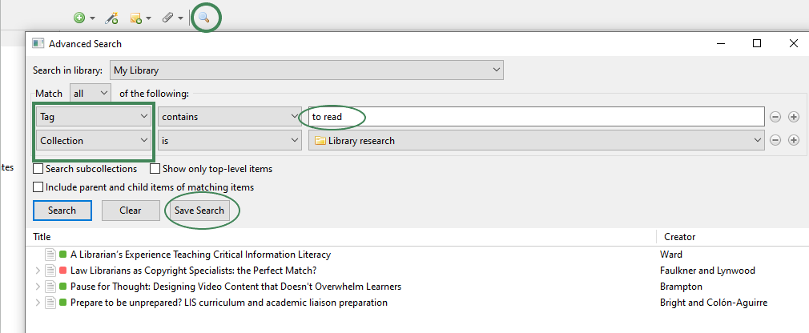
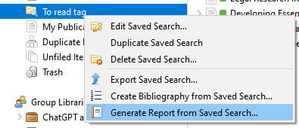
Search, report, export
Search by title, tag, collection and more
Save the search
Generate the report
Review your collection

Slide 21
Reports
Search, report, export
Create reports based on item tags, notes or authors to help with future research.
Reports are simple HTML pages that give an overview of the item metadata, notes, and attachments of the selected items. You can print them, post them to the web, and email them.
Reports are sorted alphabetically by title. For options on customising your reports, see the Zotero Reports Documentation via Zotero.org.
Reports can be created in three ways: from Collection, Search, and by using Quick Copy
From Collection
Select items within a collection
Right-click (Mac: ctrl-click) on your selection and select ‘Generate Report from Items’
A new Zotero window will open which you can print, save or post online.

Slide 22
Reports continued
Search, report , export
Create reports based on item tags, notes or authors to help with future research.
From Search
Use the Advanced Search form to retrieve items based on your search criteria
Save the search
Return to Zotero library and right-click the saved search
Select ‘Generate a report’
Quick Copy
Generate a reference list in Word by highlighting a selection of items in your Zotero library and dragging and dropping (or copying with Ctrl-Shift-C) into an open Word file. Holding Shift while you drag and drop (or using Ctrl-Shift- A) will export citations or footnote-style references.
To choose the Citation Style for Quick Copy output, go to Zotero Preferences > Export and choose your style from the dropdown menu.
Further information: www.zotero.org/support/reports

Slide 23
Create
Add items to your Zotero library.
Annotate
Search, report, export
Create reports based on item tags, notes or authors to help with future research.
Tag
Ensure your items are easy to find later by tagging the items.
Annotate PDFs while you read, generating notes as you go. Notes can also be tagged.
Create folders to keep them organised and share.
Recap…

Slide 24
Remember
Your library will only be as good as its metadata: Invest in your library and reap the rewards!

Slide 25
Thank you
Forums
https://forums.Zotero.org/
www.youtube.com/user/ZoteroVideo
Presenters
Gemma Walsh: gemma.walsh@unimelb.edu.au
Nicole Le Grand: nicole.legrand@unimelb.edu.au

